Slide 1
Learning to Program in Python
Concept 4
More Conditionals
(if else elif statements)
Notes:
This lesson will focus on if..elif..else statements. It is assumed the previous lesson on if statements has been covered.
It is assumed that variables, data types, casting and basic input-output have been covered before this lesson.
Conditionals are considered by many to be the first key Threshold Concept in learning how to Program.
The tasks and ideas would require several classes to ensure students have time to engage with the concept.

Slide 2
Learning Intentions
From this lesson the students will:
Understand the concept of Boolean expression
Evaluate simple Boolean expression
Evaluate complex Boolean expressions
Notes:
The main Learning Outcomes (LO) achieved are highlighted throughout the lesson and tasks.
The list is not exhaustive, and consultation with the LCCS spec is encouraged at all times throughout the implementation of the course.

Slide 3
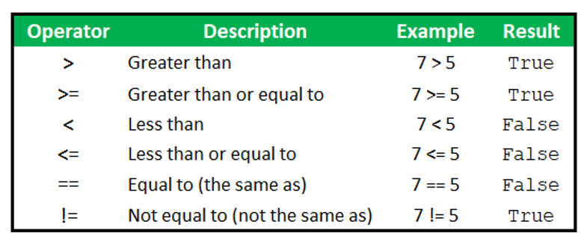
Python Relational Operators
Execute your code
Notes:
A FLOW chart representation ….

Slide 4
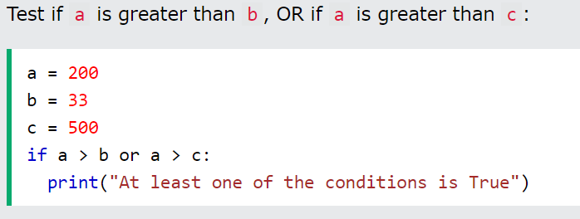
if.. statements using or
Notes:
elif stands for “else if”
Note that the else statement sweeps up any condition that wasn’t True in the preceding if..elif statements.
temp = 70 will output : Temperature is between 40 – 70
temp = 40 will output : Temperature is between 0 – 40.
temp = 0 will output : Temperature is between 0 – 40.
temp = -5 will output : Temperature is less than zero.

Slide 5
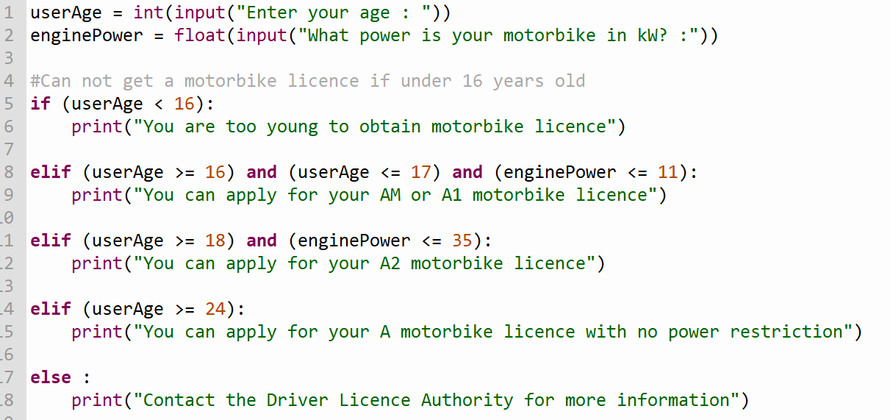
if..elif..else statements and
Notes:
elif stands for “else if”
Note that the else statement sweeps up any condition that wasn’t True in the preceding if..elif statements.
temp = 70 will output : Temperature is between 40 – 70
temp = 40 will output : Temperature is between 0 – 40.
temp = 0 will output : Temperature is between 0 – 40.
temp = -5 will output : Temperature is less than zero.

Slide 6
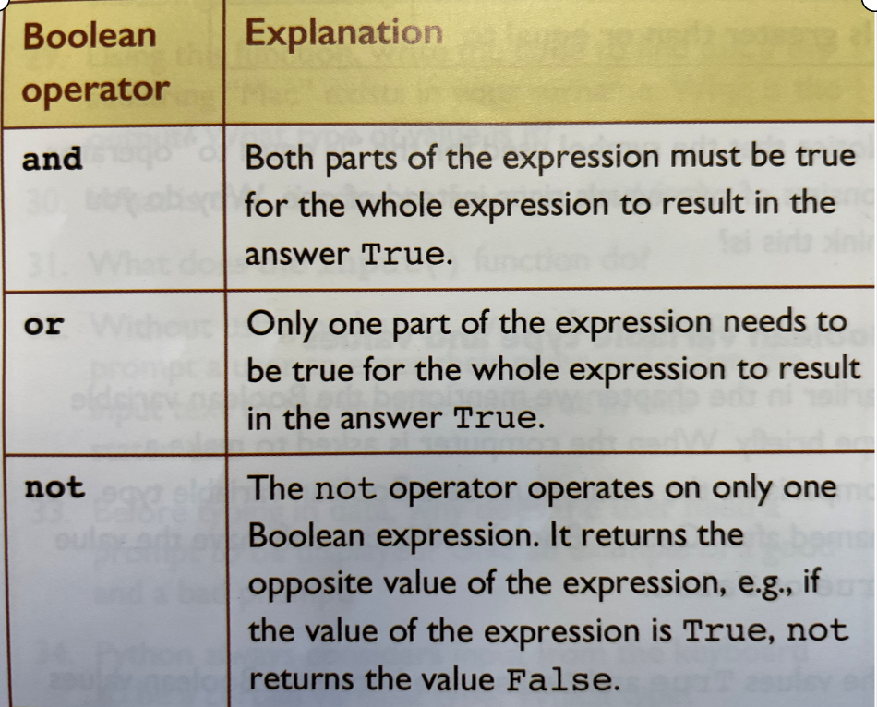
Python Operators- and, or, not
Execute your code
Notes:
A FLOW chart representation ….

Slide 7
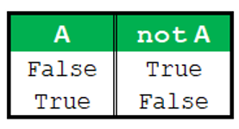
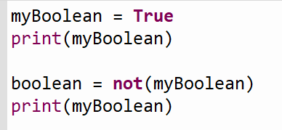
Boolean operator - not
Execute your code
Notes:
A FLOW chart representation ….

Slide 8
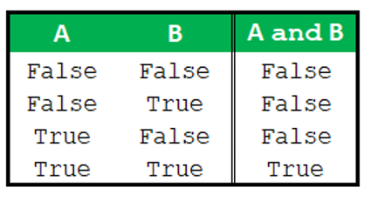
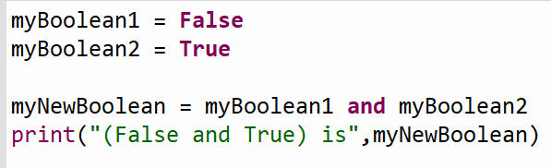
Boolean Operator - and
Notes:
A FLOW chart representation ….

Slide 9
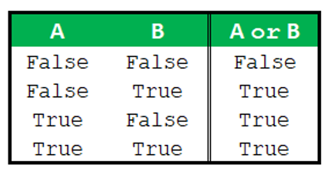
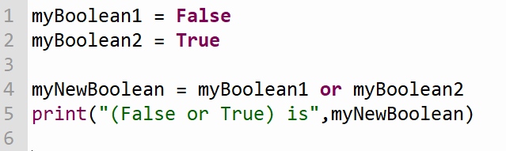
Boolean Operator - or
Notes:
A FLOW chart representation ….

Slide 10
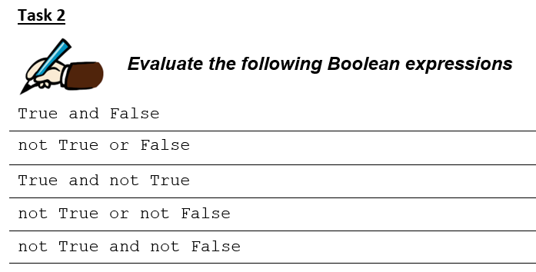
Practice
Notes:
A FLOW chart representation ….

Slide 11
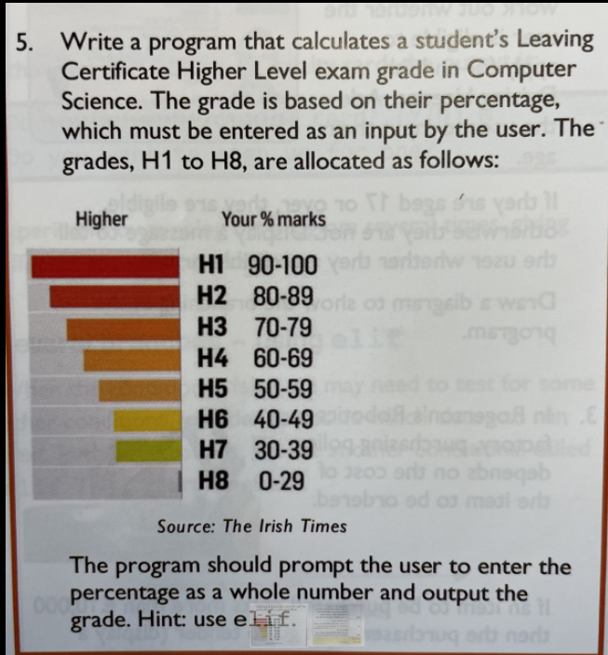
Create a program
Notes:
The partially written solution above is to suggest a way of coding the program to convert marks to grades.
The student will need to add a lot more code to this to solve the entire problem.
When complete and working, the students could try to enhance their code to check for marks entered that are not between 0 and 100%.

Slide 12
Lesson Review
As a result of this lesson I am able to:
Understand the concept of conditional if, else and elif statements.
Read and Write code to improve on previous programs.
Design programs with a better User Interface (UI)
Notes:
Review the extent to which the L)s have been achieved in these tasks, and also in the CT challenge, the eTasks, the equivalent program written in Scratch, and the microbit and conditionals in Python videos. The main LOs addressed are Students should be able to :
1.1 describe a systematic process for solving problems and making decisions
1.2 explain how the power of computing enables different solutions to difficult problems
1.4 solve problems using skills of logic
1.22 read, write, test, and modify computer programs
1.23 reflect and communicate on the design and development process
2.20 identify and fix/debug warnings and errors in computer code and modify as required
1.15 consider the quality of the user experience when interacting with computers (further elements of this LO developed at a later stage)

